Slide 1

Software
Design

Slide 2
Software Design
More creative than analysis
Problem solving activity
WHAT IS DESIGN
‘HOW’
Software design document (SDD)

Slide 3
Software Design
Initial requirements
Gather data on user requirements
Analyze requirements data
Validate the design against the requirements
Obtain answers to requirement questions
Conceive of a high level design
Refine & document the design
Completed design
Fig. 1 : Design framework

Slide 4
Software Design
design
Satisfy
Customer
Developers
(Implementers)

Slide 5
Software Design
Conceptual Design and Technical Design
Designers
What
How
Conceptual design
Technical design
A two part design process
System Builders
Customer
Fig. 2 : A two part design process

Slide 6
Software Design
Conceptual design answers :
  Where will the data come from ?
  What will happen to data in the system?
  How will the system look to users?
  What choices will be offered to users?
  What is the timings of events?
  How will the reports & screens look like?

Slide 7
Software Design
Technical design describes :
  Hardware configuration
  Software needs
  Communication interfaces
  I/O of the system
  Software architecture
  Network architecture
  Any other thing that translates the requirements in to a solution to the customer’s problem.

Slide 8
Software Design
The design needs to be
  Correct & complete
  Understandable
  At the right level
  Maintainable

Slide 9
Software Design
Informal design outline
Informal design
More formal design
Finished design
Fig. 3 : The transformation of an informal design to a detailed design.

Slide 10
Software Design
MODULARITY
There are many definitions of the term module. Range is from :
  Fortran subroutine
  Ada package
  Procedures & functions of PASCAL & C
  C++ / Java classes
  Java packages
  Work assignment for an individual programmer

Slide 11
Software Design
All these definitions are correct. A modular system consist of well defined manageable units with well defined interfaces among the units.

Slide 12
Software Design
Properties :
  Well defined subsystem
  Well defined purpose
  Can be separately compiled and stored in a library.
  Module can use other modules
  Module should be easier to use than to build
  Simpler from outside than from the inside.

Slide 13
Software Design
Modularity is the single attribute of software that allows a program to be intellectually manageable.
It enhances design clarity, which in turn eases implementation, debugging, testing, documenting, and maintenance of software product.

Slide 14
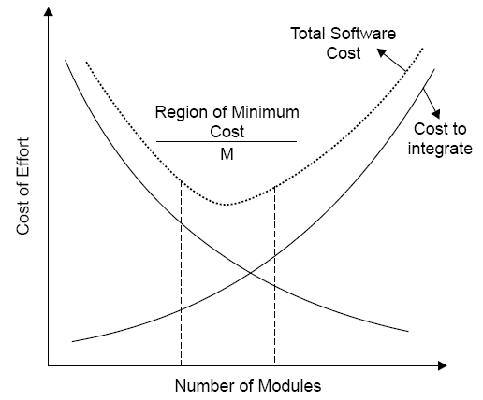
Software Design
Fig. 4 : Modularity and software cost

Slide 15
Software Design
Module Coupling
Coupling is the measure of the degree of interdependence between modules.
(Uncoupled : no dependencies)
(a)

Slide 16
Software Design
Loosely coupled: some dependencies
(B)
Highly coupled: many dependencies
(C)
Fig. 5 : Module coupling

Slide 17
Software Design
This can be achieved as:
Controlling the number of parameters passed amongst modules.
Avoid passing undesired data to calling module.
Maintain parent / child relationship between calling & called modules.
Pass data, not the control information.

Slide 18
Software Design
Consider the example of editing a student record in a ‘student information system’.
Edit student record
Edit student record
Student name, student ID, address, course
Student record EOF
Student ID
Student record EOF
Retrieve student record
Retrieve student record
Poor design: Tight Coupling
Good design: Loose Coupling
Fig. 6 : Example of coupling

Slide 19
Software Design
Data coupling | Best
Stamp coupling
Control coupling
External coupling
Common coupling
Content coupling | Worst
Fig. 7 : The types of module coupling
Given two procedures A & B, we can identify number of ways in which they can be coupled.

Slide 20
Software Design
Data coupling
The dependency between module A and B is said to be data coupled if their dependency is based on the fact they communicate by only passing of data. Other than communicating through data, the two modules are independent.
Stamp coupling
Stamp coupling occurs between module A and B when complete data structure is passed from one module to another.

Slide 21
Software Design
Control coupling
Module A and B are said to be control coupled if they communicate by passing of control information. This is usually accomplished by means of flags that are set by one module and reacted upon by the dependent module.
Common coupling
With common coupling, module A and module B have shared data. Global data areas are commonly found in programming languages. Making a change to the common data means tracing back to all the modules which access that data to evaluate the effect of changes.

Slide 22
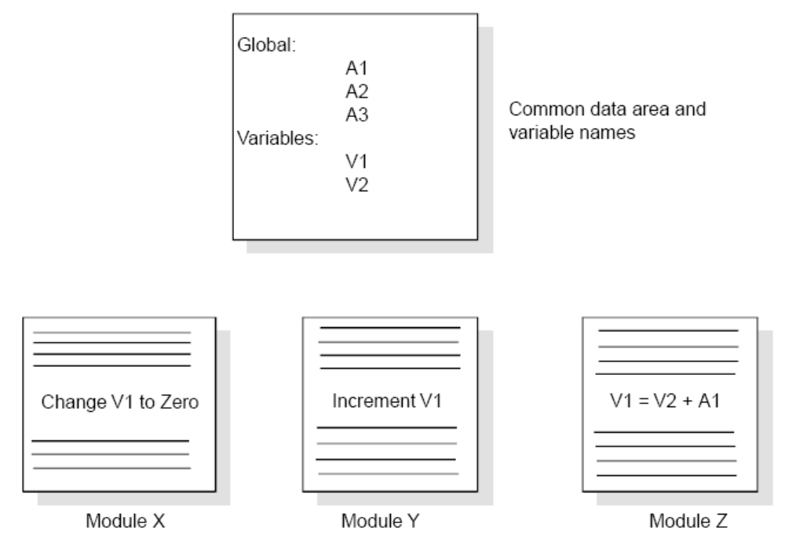
Software Design
Fig. 8 : Example of common coupling

Slide 23
Software Design
Content coupling
Content coupling occurs when module A changes data of module B or when control is passed from one module to the middle of another. In Fig. 9, module B branches into D, even though D is supposed to be under the control of C.

Slide 24
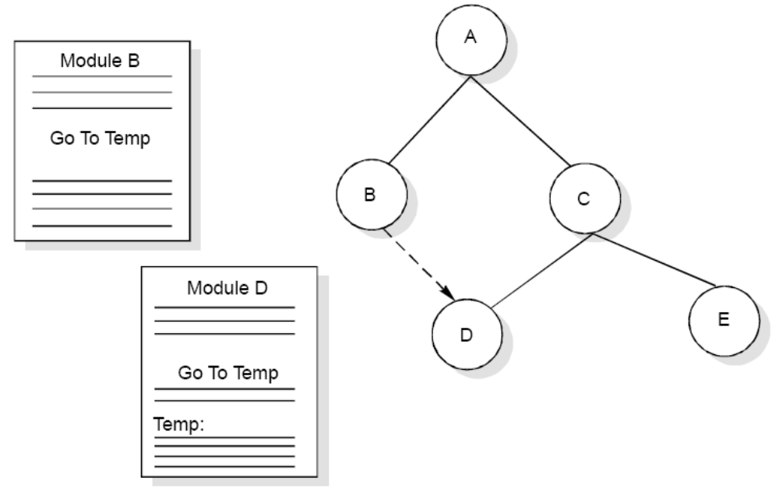
Software Design
Fig. 9 : Example of content coupling

Slide 25
Software Design
Module Cohesion
Cohesion is a measure of the degree to which the elements of a module are functionally related.
Module strength
Fig. 10 : Cohesion=Strength of relations within modules

Slide 26
Software Design
Types of cohesion
Functional cohesion
Sequential cohesion
Procedural cohesion
Temporal cohesion
Logical cohesion
Coincident cohesion

Slide 27
Software Design
Functional Cohesion | Best (high)
Sequential Cohesion
Communicational Cohesion
Procedural Cohesion
Temporal Cohesion
Logical Cohesion
Coincidental Cohesion | Worst (low)
Fig. 11 : Types of module cohesion

Slide 28
Software Design
Functional Cohesion
A and B are part of a single functional task. This is very good reason for them to be contained in the same procedure.
Sequential Cohesion
Module A outputs some data which forms the input to B. This is the reason for them to be contained in the same procedure.

Slide 29
Software Design
Procedural Cohesion
Procedural Cohesion occurs in modules whose instructions although accomplish different tasks yet have been combined because there is a specific order in which the tasks are to be completed.
Temporal Cohesion
Module exhibits temporal cohesion when it contains tasks that are related by the fact that all tasks must be executed in the same time-span.

Slide 30
Software Design
Logical Cohesion
Logical cohesion occurs in modules that contain instructions that appear to be related because they fall into the same logical class of functions.
Coincidental Cohesion
Coincidental cohesion exists in modules that contain instructions that have little or no relationship to one another.

Slide 31
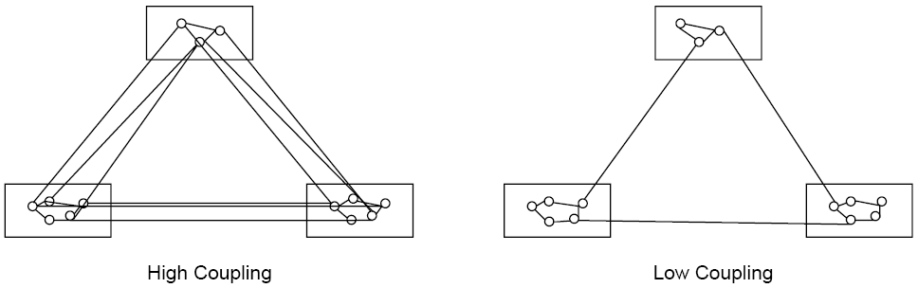
Software Design
Relationship between Cohesion & Coupling
If the software is not properly modularized, a host of seemingly trivial enhancement or changes will result into death of the project. Therefore, a software engineer must design the modules with goal of high cohesion and low coupling.
Fig. 12 : View of cohesion and coupling

Slide 32
Software Design
STRATEGY OF DESIGN
A good system design strategy is to organize the program modules in such a way that are easy to develop and latter to, change. Structured design techniques help developers to deal with the size and complexity of programs. Analysts create instructions for the developers about how code should be written and how pieces of code should fit together to form a program. It is important for two reasons:
First, even pre-existing code, if any, needs to be understood, organized and pieced together.
Second, it is still common for the project team to have to write some code and produce original programs that support the application logic of the system.

Slide 33
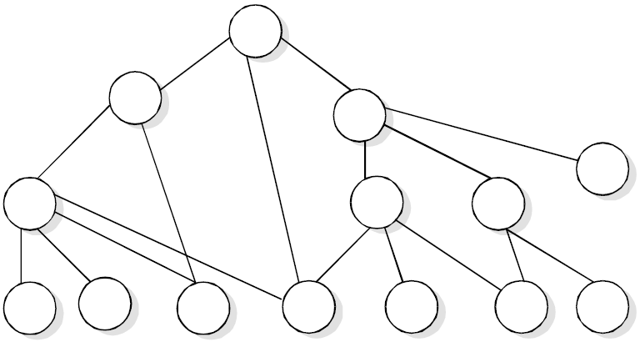
Software Design
Bottom-Up Design
These modules are collected together in the form of a “library”.
Fig. 13 : Bottom-up tree structure

Slide 34
Software Design
Top-Down Design
A top down design approach starts by identifying the major modules of the system, decomposing them into their lower level modules and iterating until the desired level of detail is achieved. This is stepwise refinement; starting from an abstract design, in each step the design is refined to a more concrete level, until we reach a level where no more refinement is needed and the design can be implemented directly.

Slide 35
Software Design
Hybrid Design
For top-down approach to be effective, some bottom-up approach is essential for the following reasons:
To permit common sub modules.
Near the bottom of the hierarchy, where the intuition is simpler, and the need for bottom-up testing is greater, because there are more number of modules at low levels than high levels.
In the use of pre-written library modules, in particular, reuse of modules.

Slide 36
Software Design
FUNCTION ORIENTED DESIGN
Function Oriented design is an approach to software design where the design is decomposed into a set of interacting units where each unit has a clearly defined function. Thus, system is designed from a functional viewpoint.

Slide 37
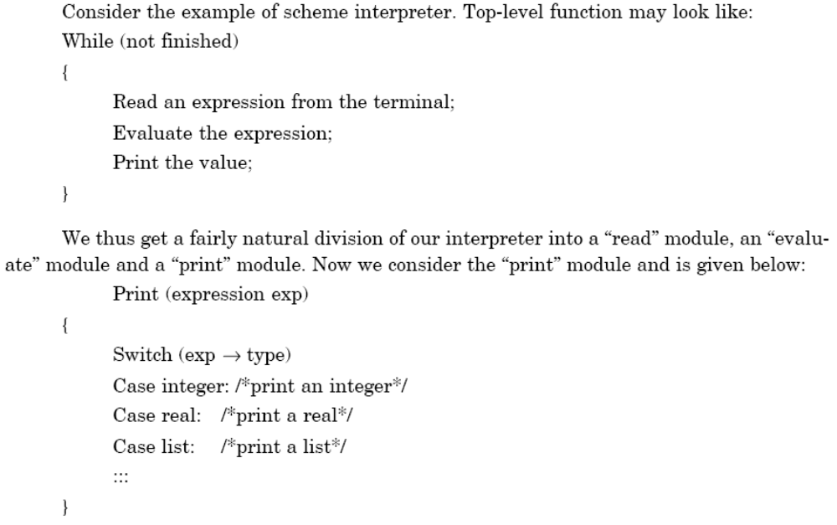
Software Design

Slide 38
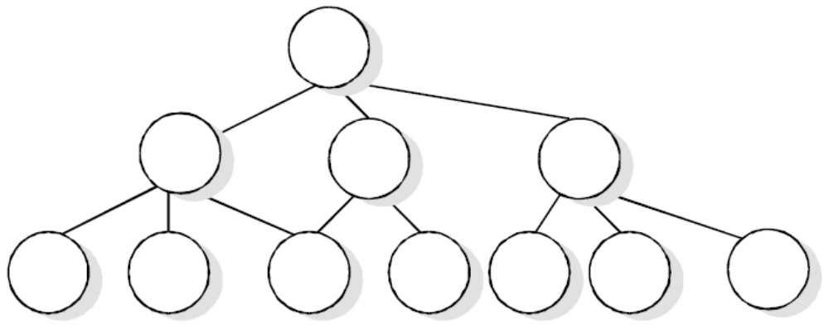
Software Design
We continue the refinement of each module until we reach the statement level of our programming language. At that point, we can describe the structure of our program as a tree of refinement as in design top-down structure as shown in fig. 14.
Fig. 14 : Top-down structure

Slide 39
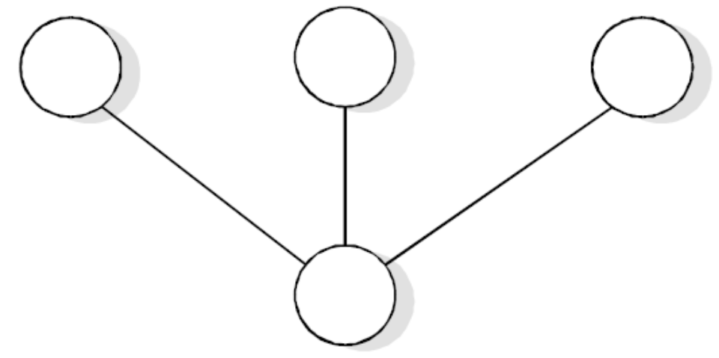
Software Design
If a program is created top-down, the modules become very specialized. As one can easily see in top down design structure, each module is used by at most one other module, its parent. For a module, however, we must require that several other modules as in design reusable structure as shown in fig. 15.
Fig. 15 : Design reusable structure

Slide 40
Software Design
Design Notations
Design notations are largely meant to be used during the process of design and are used to represent design or design decisions. For a function oriented design, the design can be represented graphically or mathematically by the following:
Data flow diagrams
Data Dictionaries
Structure Charts
Pseudocode

Slide 41
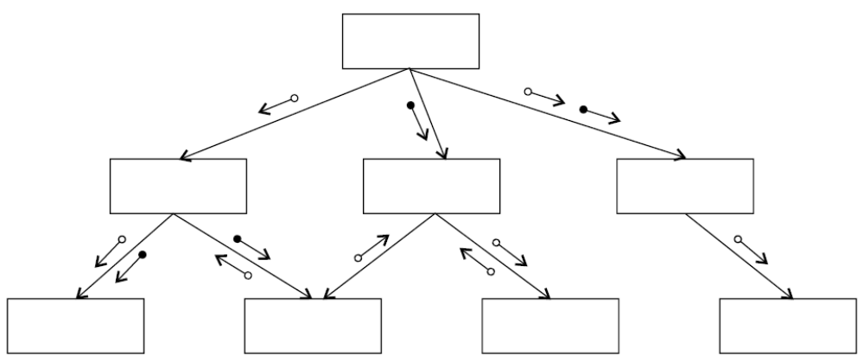
Software Design
Structure Chart
It partition a system into block boxes. A black box means that functionality is known to the user without the knowledge of internal design.
Fig. 16 : Hierarchical format of a structure chart

Slide 42
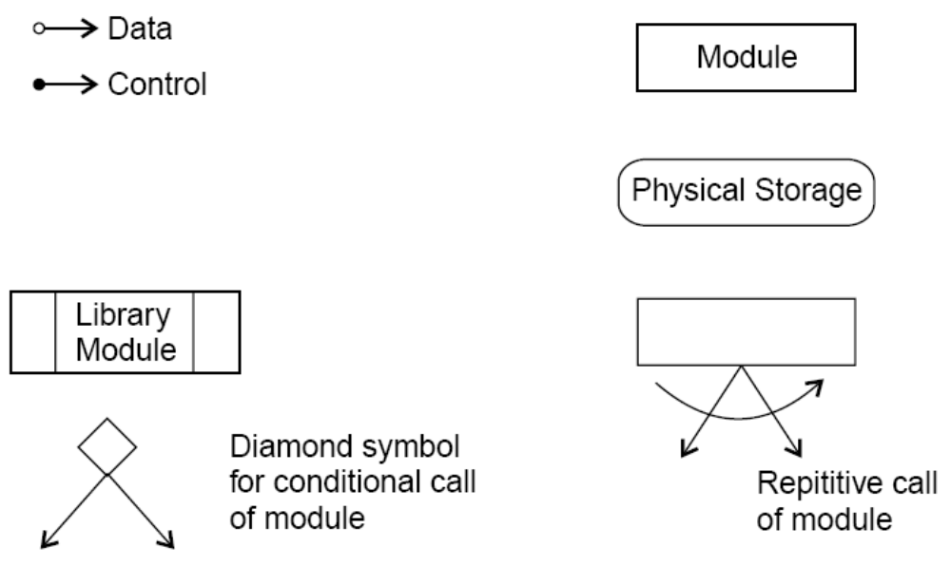
Software Design
Fig. 17 : Structure chart notations

Slide 43
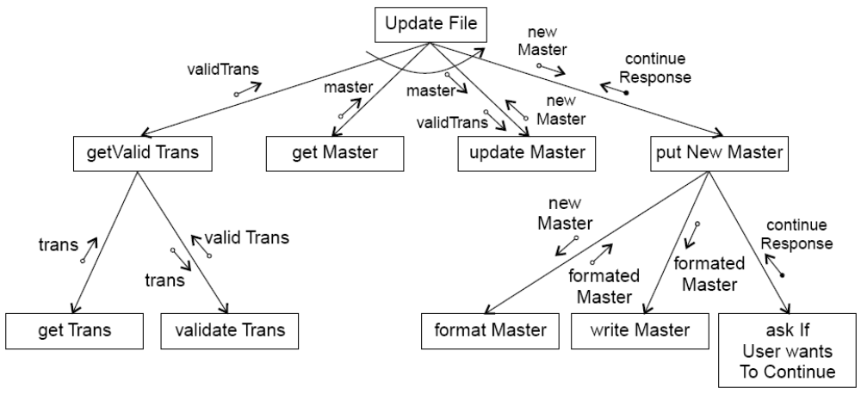
Software Design
A structure chart for “update file” is given in fig. 18.
Fig. 18 : Update file

Slide 44
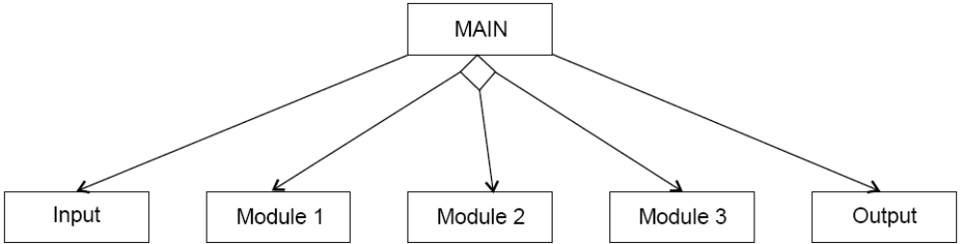
Software Design
A transaction centered structure describes a system that processes a number of different types of transactions. It is illustrated in Fig.19.
Fig. 19 : Transaction-centered structure

Slide 45
Software Design
In the above figure the MAIN module controls the system operation its functions is to:
invoke the INPUT module to read a transaction;
determine the kind of transaction and select one of a number of transaction modules to process that transaction, and
output the results of the processing by calling OUTPUT module.

Slide 46
Software Design
Pseudocode
Pseudocode notation can be used in both the preliminary and detailed design phases.
Using pseudocode, the designer describes system characteristics using short, concise, English language phrases that are structured by key words such as It-Then-Else, While-Do, and End.

Slide 47
Software Design
Functional Procedure Layers
Function are built in layers, Additional notation is used to specify details.
Level 0
Function or procedure name
Relationship to other system components (e.g., part of which system, called by which routines, etc.)
Brief description of the function purpose.
Author, date

Slide 48
Software Design
Level 1
Function Parameters (problem variables, types, purpose, etc.)
Global variables (problem variable, type, purpose, sharing information)
Routines called by the function
Side effects
Input/Output Assertions

Slide 49
Software Design
Level 2
Local data structures (variable etc.)
Timing constraints
Exception handling (conditions, responses, events)
Any other limitations
Level 3
Body (structured chart, English pseudo code, decision tables, flow charts, etc.)

Slide 50
Software Design
IEEE Recommended practice for software design descriptions (IEEE STD 1016-1998)
Scope
An SDD is a representation of a software system that is used as a medium for communicating software design information.
References
IEEE std 830-1998, IEEE recommended practice for software requirements specifications.
IEEE std 610.12-1990, IEEE glossary of software engineering terminology.

Slide 51
Software Design
Definitions
Design entity. An element (Component) of a design that is structurally and functionally distinct from other elements and that is separately named and referenced.
Design View. A subset of design entity attribute information that is specifically suited to the needs of a software project activity.
Entity attributes. A named property or characteristics of a design entity. It provides a statement of fact about the entity.
Software design description (SDD). A representation of a software system created to facilitate analysis, planning, implementation and decision making.

Slide 52
Software Design
Purpose of an SDD
The SDD shows how the software system will be structured to satisfy the requirements identified in the SRS. It is basically the translation of requirements into a description of the software structure, software components, interfaces, and data necessary for the implementation phase. Hence, SDD becomes the blue print for the implementation activity.
Design Description Information Content
Introduction
Design entities
Design entity attributes

Slide 53
Software Design
The attributes and associated information items are defined in the following subsections:
Identification
Dependencies
Type
Interface
Purpose
Resources
Function
Processing
Subordinates
Data

Slide 54
Software Design
Design Description Organization
Each design description writer may have a different view of what are considered the essential aspects of a software design. The organization of SDD is given in table 1. This is one of the possible ways to organize and format the SDD.
A recommended organization of the SDD into separate design views to facilitate information access and assimilation is given in table 2.

Slide 55
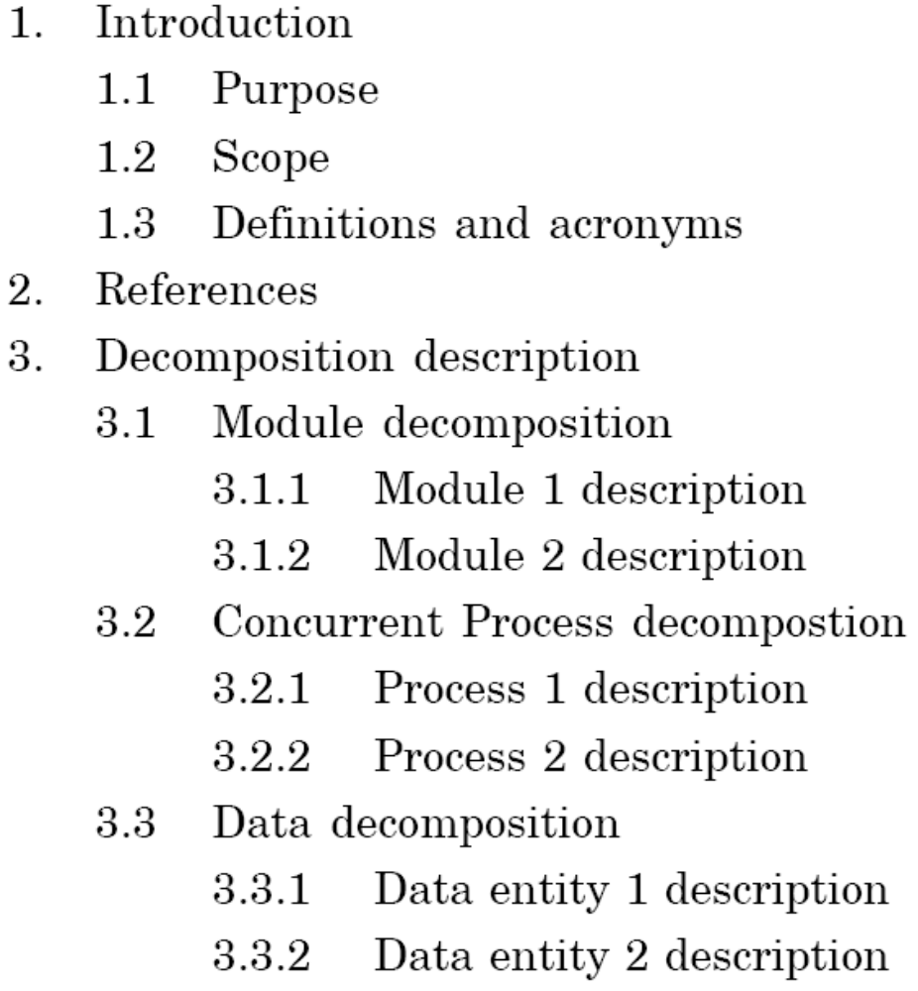
Software Design
Cont…

Slide 56
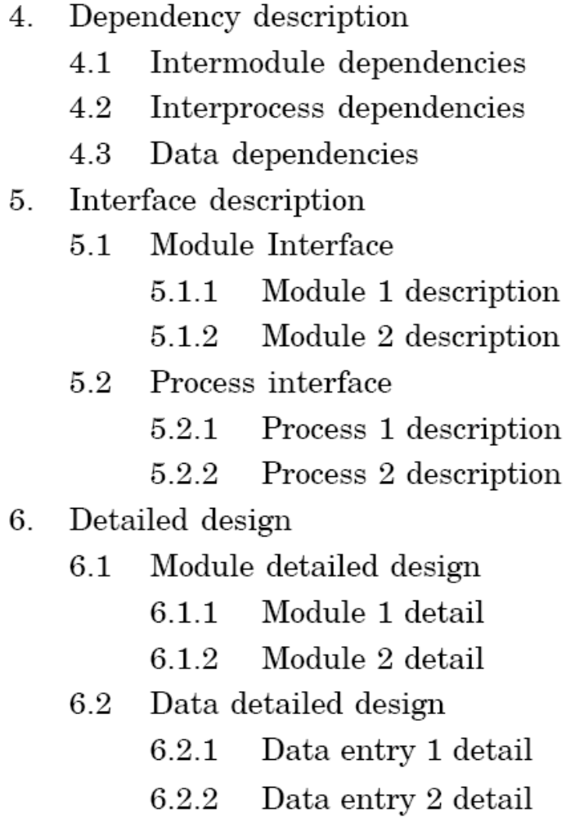
Software Design
Table 1: Organization of SDD

Slide 57
Software Design
Design View | Scope | Entity attribute | Example representation
Decomposition description | Partition of the system into design entities | Identification, type purpose, function, subordinate | Hierarchical decomposition diagram, natural language
Dependency description | Description of relationships among entities of system resources | Identification, type, purpose, dependencies, resources | Structure chart, data flow diagrams, transaction diagrams
Interface description | List of everything a designer, developer, tester needs to know to use design entities that make up the system | Identification, function, interfaces | Interface files, parameter tables
Detail description | Description of the internal design details of an entity | Identification, processing, data | Flow charts, PDL etc.
Table 2: Design views

Slide 58
Software Design
Object Oriented Design
Object oriented design is the result of focusing attention not on the function performed by the program, but instead on the data that are to do manipulated by the program. Thus, it is orthogonal to function oriented design.
Object Oriented Design begins with an examination of the real world “things” that are part of the problem to be solved. These things (which we will call objects) are characterized individually in terms of their attributes and behavior.

Slide 59
Software Design
Basic Concepts
Object Oriented Design is not dependent on any specific implementation language. Problems are modeled using objects. Objects have:
Behavior (they do things)
State (which changes when they do things)

Slide 60
Software Design
The various terms related to object design are:
Objects
The word “Object” is used very frequently and conveys different meaning in different circumstances. Here, meaning is an entity able to save a state (information) and which offers a number of operations (behavior) to either examine or affect this state. An object is characterized by number of operations and a state which remembers the effect of these operations.

Slide 61
Software Design
Messages
Objects communicate by message passing. Messages consist of the identity of the target object, the name of the requested operation and any other operation needed to perform the function. Message are often implemented as procedure or function calls.
Abstraction
In object oriented design, complexity is managed using abstraction. Abstraction is the elimination of the irrelevant and the amplification of the essentials.

Slide 62
Software Design
Class
In any system, there shall be number of objects. Some of the objects may have common characteristics and we can group the objects according to these characteristics. This type of grouping is known as a class. Hence, a class is a set of objects that share a common structure and a common behavior.
We may define a class “car” and each object that represent a car becomes an instance of this class. In this class “car”, Indica, Santro, Maruti, Indigo are instances of this class as shown in fig. 20.
Classes are useful because they act as a blueprint for objects. If we want a new square we may use the square class and simply fill in the particular details (i.e. colour and position) fig. 21 shows how can we represent the square class.

Slide 63
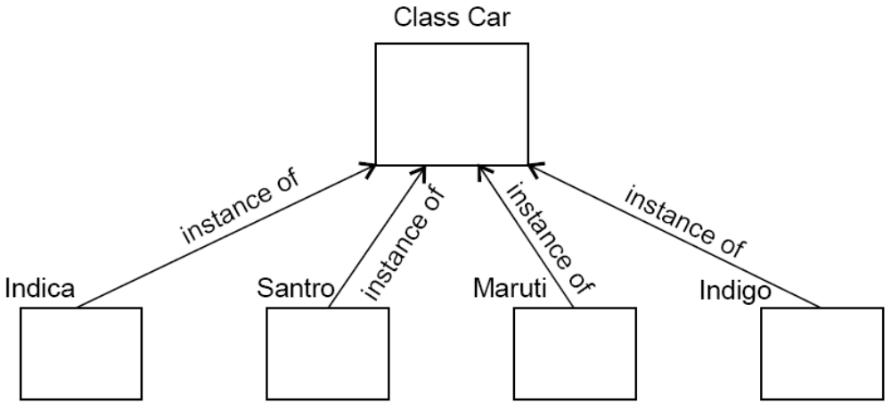
Software Design
Fig.20: Indica, Santro, Maruti, Indigo are all instances of the class “car”

Slide 64
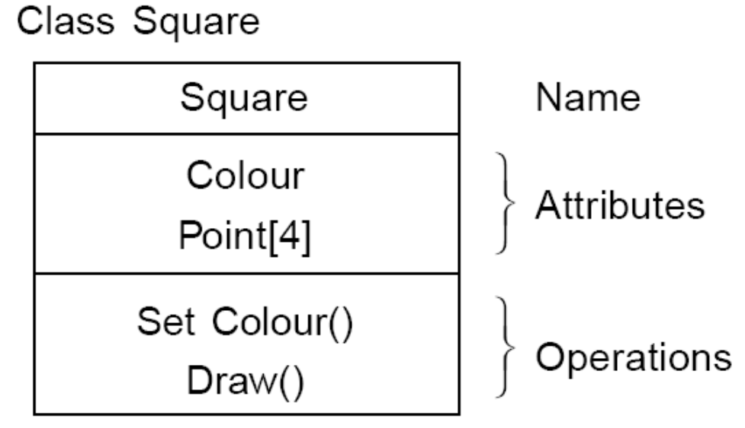
Software Design
Fig. 21: The square class

Slide 65
Software Design
v. Attributes
An attributes is a data value held by the objects in a class. The square class has two attributes: a colour and array of points. Each attributes has a value for each object instance. The attributes are shown as second part of the class as shown in fig. 21.
Operations
An operation is a function or transformation that may be applied to or by objects in a class. In the square class, we have two operations: set colour() and draw(). All objects in a class share the same operations. An object “knows” its class, and hence the right implementation of the operation. Operation are shown in the third part of the class as indicated in fig. 21.

Slide 66
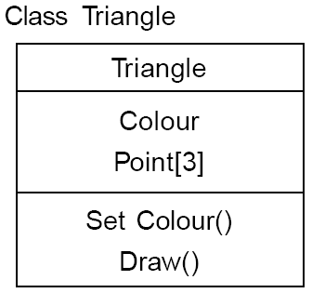
Software Design
Inheritance
Imagine that, as well as squares, we have triangle class. Fig. 22 shows the class for a triangle.
Fig. 22: The triangle class

Slide 67
Software Design
Now, comparing fig. 21 and 22, we can see that there is some difference between triangle and squares classes.
For example, at a high level of abstraction, we might want to think of a picture as made up of shapes and to draw the picture, we draw each shape in turn. We want to eliminate the irrelevant details: we do not care that one shape is a square and the other is a triangle as long as both can draw themselves.
To do this, we consider the important parts out of these classes in to a new class called Shape. Fig. 23 shows the results.

Slide 68
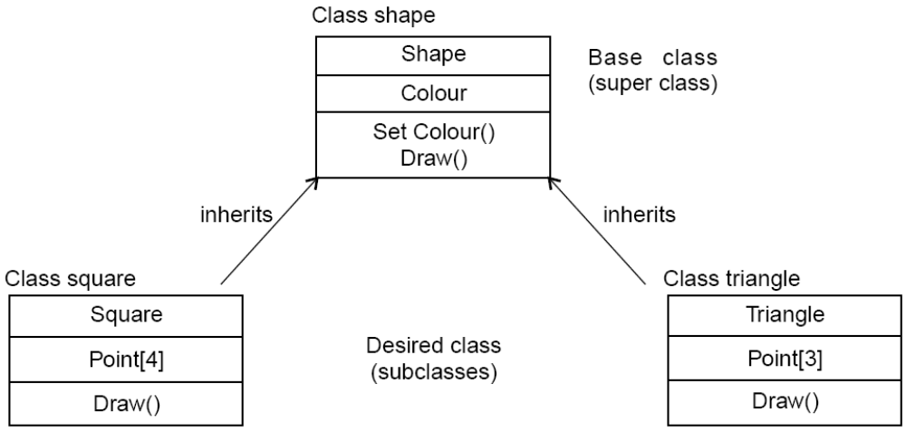
Software Design
Fig. 23: Abstracting common features in a new class
This sort of abstraction is called inheritance. The low level classes (known as subclasses or derived classes) inherit state and behavior from this high level class (known as a super class or base class).

Slide 69
Software Design
Polymorphism
When we abstract just the interface of an operation and leave the implementation to subclasses it is called a polymorphic operation and process is called polymorphism.
Encapsulation (Information Hiding)
Encapsulation is also commonly referred to as “Information Hiding”. It consists of the separation of the external aspects of an object from the internal implementation details of the object.
Hierarchy
Hierarchy involves organizing something according to some particular order or rank. It is another mechanism for reducing the complexity of software by being able to treat and express sub-types in a generic way.

Slide 70
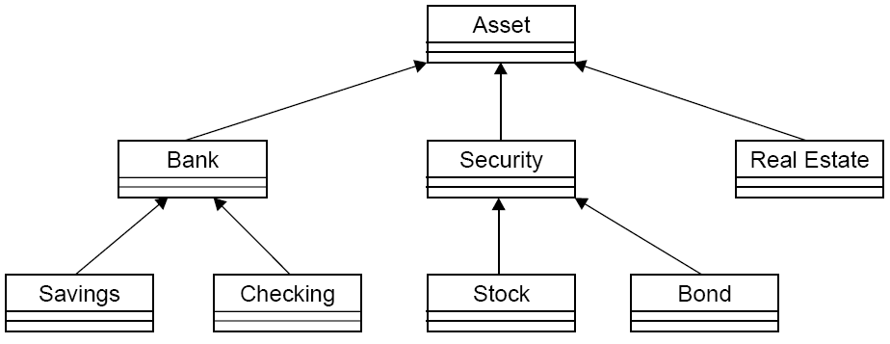
Software Design
Fig. 24: Hierarchy

Slide 71
Software Design
Steps to Analyze and Design Object Oriented System
There are various steps in the analysis and design of an object oriented system and are given in fig. 25

Slide 72
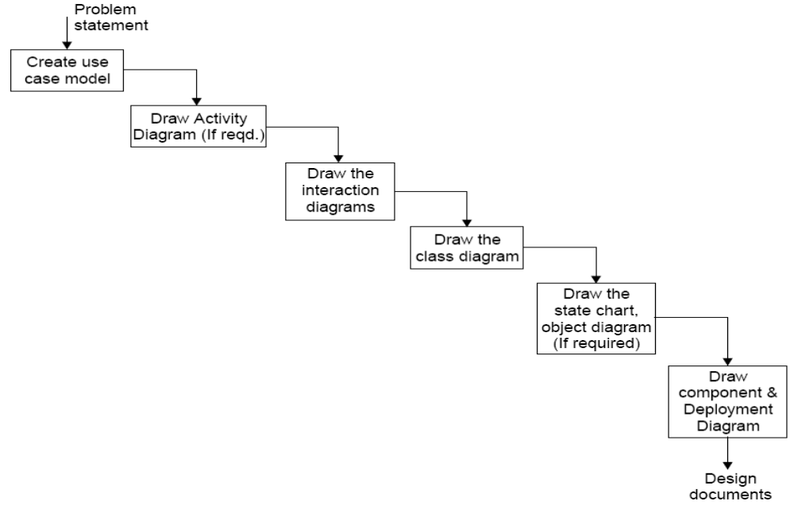
Software Design
Fig. 25: Steps for analysis & design of object oriented system

Slide 73
Software Design
Create use case model
First step is to identify the actors interacting with the system. We should then write the use case and draw the use case diagram.
Draw activity diagram (If required)
Activity Diagram illustrate the dynamic nature of a system by modeling the flow of control form activity to activity. An activity represents an operation on some class in the system that results in a change in the state of the system. Fig. 26 shows the activity diagram processing an order to deliver some goods.

Slide 74
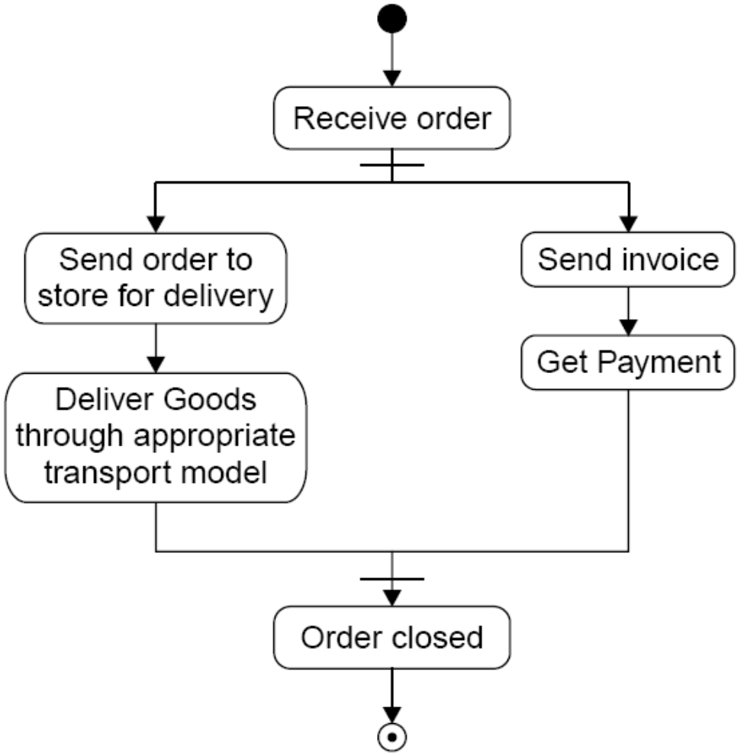
Software Design
Fig. 26: Activity diagram

Slide 75
Software Design
Draw the interaction diagram
An interaction diagram shows an interaction, consisting of a set of objects and their relationship, including the messages that may be dispatched among them. Interaction diagrams address the dynamic view of a system.
Steps to draws interaction diagrams are as under:
Firstly, we should identify that the objects with respects to every use case.
We draw the sequence diagrams for every use case.
We draw the collaboration diagrams for every use case.

Slide 76
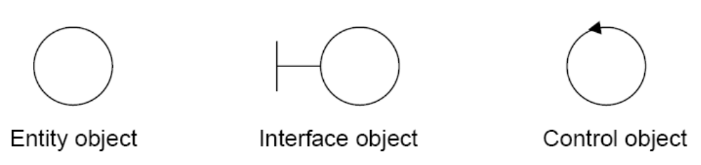
Software Design
The object types used in this analysis model are entity objects, interface objects and control objects as given in fig. 27.
Fig. 27: Object types

Slide 77
Software Design
Draw the class diagram
The class diagram shows the relationship amongst classes. There are four types of relationships in class diagrams.
Association are semantic connection between classes. When an association connects two classes, each class can send messages to the other in a sequence or a collaboration diagram. Associations can be bi-directional or unidirectional.

Slide 78
Software Design
Dependencies connect two classes. Dependencies are always unidirectional and show that one class, depends on the definitions in another class.
Aggregations are stronger form of association. An aggregation is a relationship between a whole and its parts.
Generalizations are used to show an inheritance relationship between two classes.

Slide 79
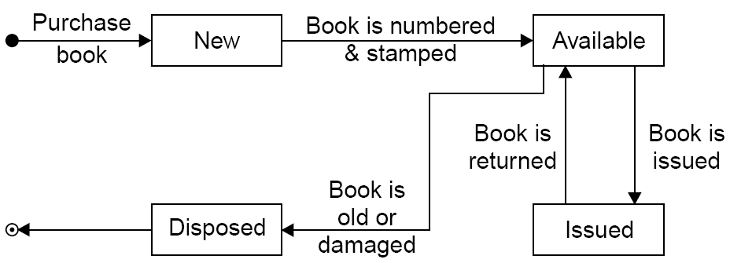
Software Design
Design of state chart diagrams
A state chart diagram is used to show the state space of a given class, the event that cause a transition from one state to another, and the action that result from a state change. A state transition diagram for a “book” in the library system is given in fig. 28.
Fig. 28: Transition chart for “book” in a library system.

Slide 80
Software Design
Draw component and development diagram
Component diagrams address the static implementation view of a system they are related to class diagrams in that a component typically maps to one or more classes, interfaces or collaboration.
Deployment Diagram Captures relationship between physical components and the hardware.

Slide 81
Software Design
A software has to be developed for automating the manual library of a University. The system should be stand alone in nature. It should be designed to provide functionality’s as explained below:
Issue of Books:
  A student of any course should be able to get books issued.
  Books from General Section are issued to all but Book bank books are issued only for their respective courses.
  A limitation is imposed on the number of books a student can issue.
  A maximum of 4 books from Book bank and 3 books from General section is issued for 15 days only.The software takes the current system date as the date of issue and calculates date of return.

Slide 82
Software Design
  A bar code detector is used to save the student as well as book information.
  The due date for return of the book is stamped on the book.
Return of Books:
  Any person can return the issued books.
  The student information is displayed using the bar code detector.
  The system displays the student details on whose name the books were issued as well as the date of issue and return of the book.
  The system operator verifies the duration for the issue.
  The information is saved and the corresponding updating take place in the database.

Slide 83
Software Design
  Query Processing:
  The system should be able to provide information like:
  Availability of a particular book.
  Availability of book of any particular author.
  Number of copies available of the desired book.
The system should also be able to generate reports regarding the details of the books available in the library at any given time. The corresponding printouts for each entry (issue/return) made in the system should be generated. Security provisions like the ‘login authenticity should be provided. Each user should have a user id and a password. Record of the users of the system should be kept in the log file. Provision should be made for full backup of the system.

Slide 84
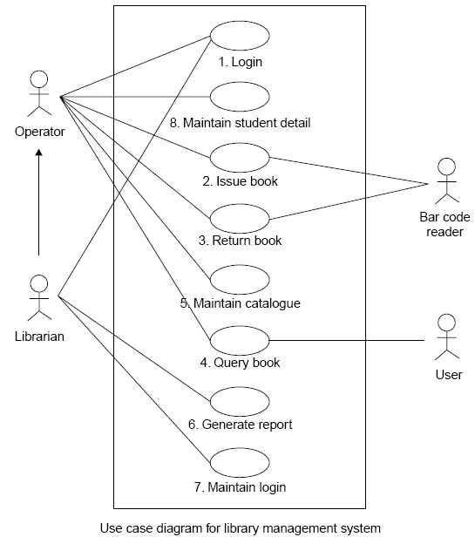
Software Design

Slide 85
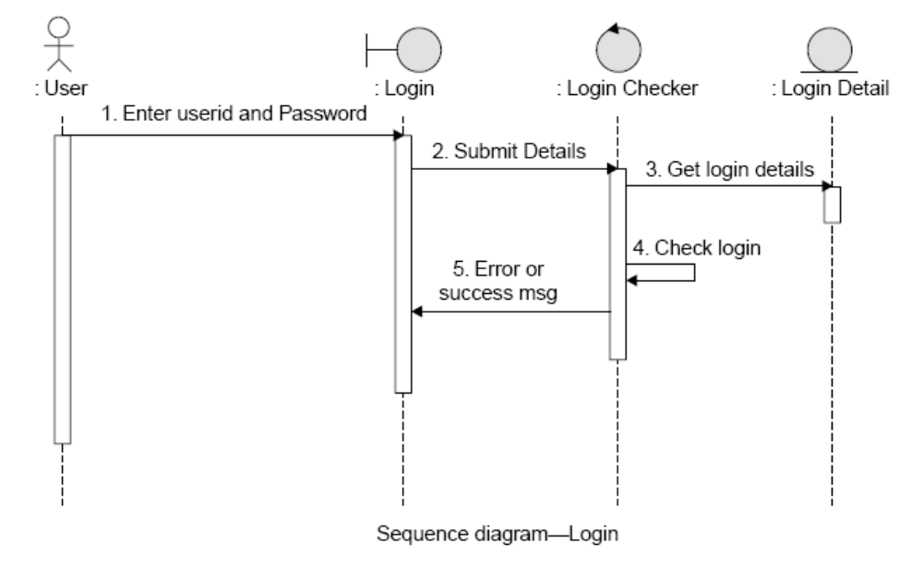
Software Design

Slide 86
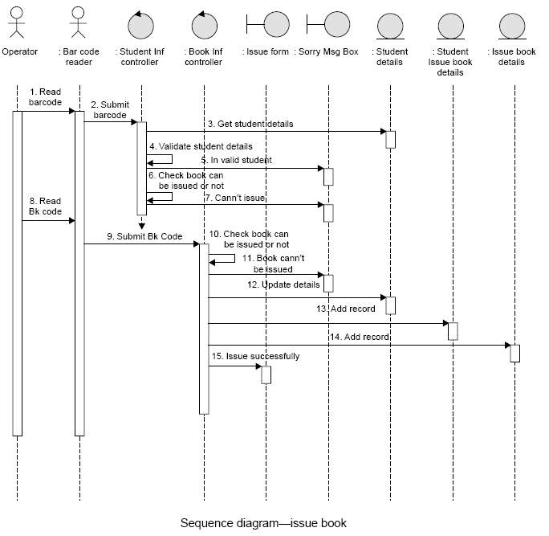
Software Design

Slide 87
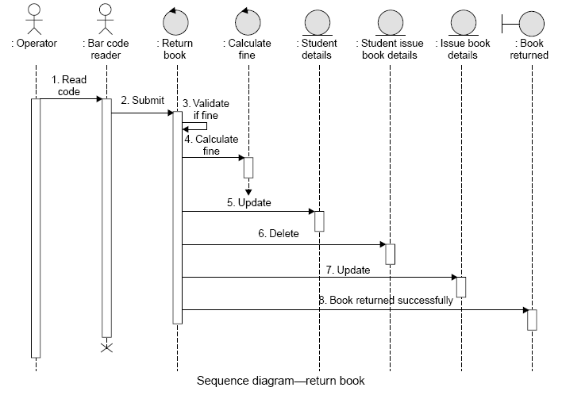
Software Design

Slide 88
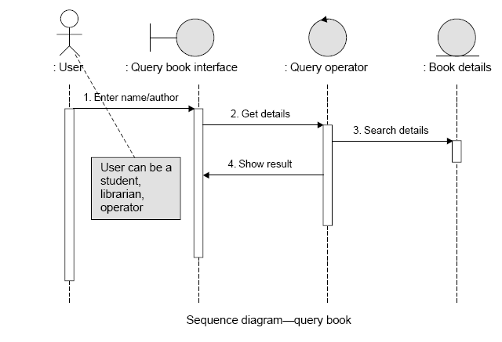
Software Design

Slide 89
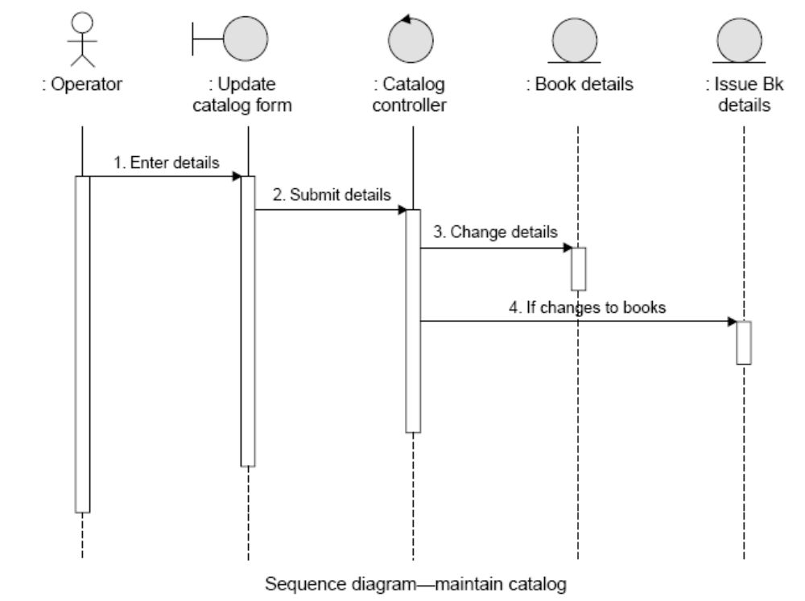
Software Design

Slide 90
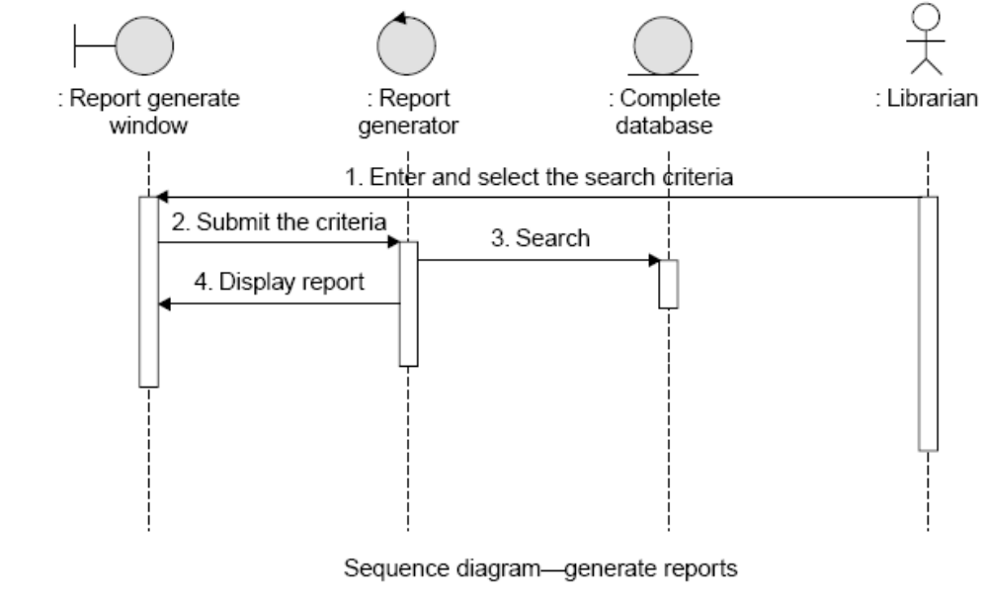
Software Design

Slide 91
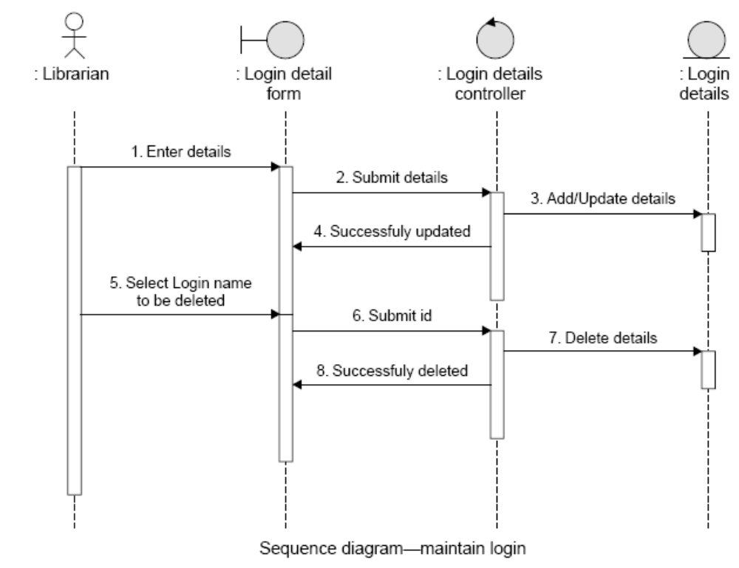
Software Design

Slide 92
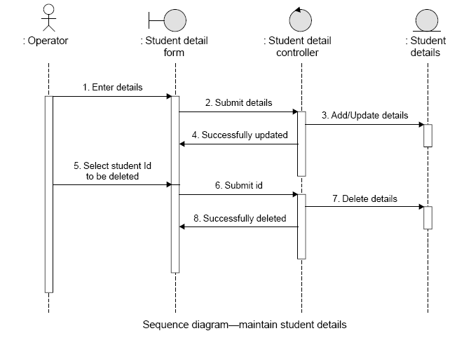
Software Design

Slide 93
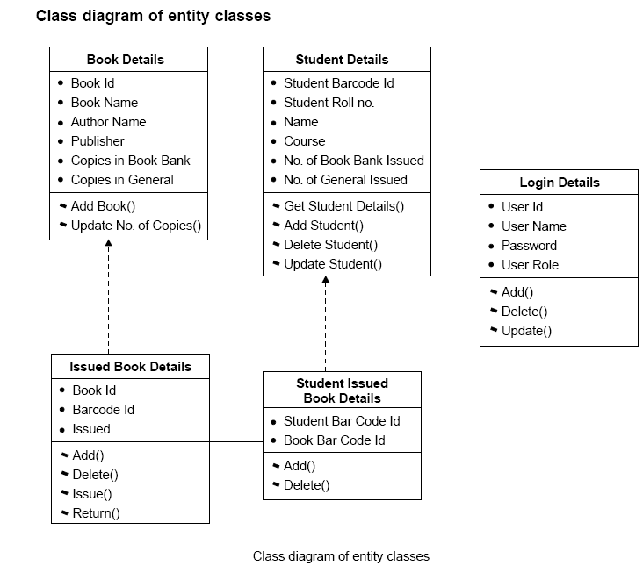
Software Design

Slide 94
Multiple Choice Questions
Note: Choose most appropriate answer of the following questions:
5.1 The most desirable form of coupling is
(a) Control Coupling (b) Data Coupling
(c) Common Coupling (d) Content Coupling
5.2 The worst type of coupling is
(a) Content coupling (b) Common coupling
(c) External coupling (d) Data coupling
5.3 The most desirable form of cohesion is
(a) Logical cohesion (b) Procedural cohesion
(c) Functional cohesion (d) Temporal cohesion
5.4 The worst type of cohesion is
(a) Temporal cohesion (b) Coincidental cohesion
(c) Logical cohesion (d) Sequential cohesion
5.5 Which one is not a strategy for design?
(a) Bottom up design (b) Top down design
(c) Embedded design (d) Hybrid design

Slide 95
Multiple Choice Questions
5.6 Temporal cohesion means
(a) Cohesion between temporary variables
(b) Cohesion between local variable
(c) Cohesion with respect to time
(d) Coincidental cohesion
5.7 Functional cohesion means
(a) Operations are part of single functional task and are placed in same procedures
(b) Operations are part of single functional task and are placed in multiple procedures
(c) Operations are part of multiple tasks
(d) None of the above
5.8 When two modules refer to the same global data area, they are related as
(a) External coupled (b) Data coupled
(c) Content coupled (d) Common coupled
5.9 The module in which instructions are related through flow of control is
(a) Temporal cohesion (b) Logical cohesion
(c) Procedural cohesion (d) Functional cohesion

Slide 96
Multiple Choice Questions
5.10 The relationship of data elements in a module is called
(a) Coupling (b) Cohesion
(c) Modularity (d) None of the above
5.11 A system that does not interact with external environment is called
(a) Closed system (b) Logical system
(c) Open system (d) Hierarchal system
5.12 The extent to which different modules are dependent upon each other is called
(a) Coupling (b) Cohesion
(c) Modularity (d) Stability

Slide 97
Exercises
5.1 What is design? Describe the difference between conceptual design and technical design.
5.2 Discuss the objectives of software design. How do we transform an informal design to a detailed design?
5.3 Do we design software when we “write” a program? What makes software design different from coding?
5.4 What is modularity? List the important properties of a modular system.
5.5 Define module coupling and explain different types of coupling.
5.6 Define module cohesion and explain different types of cohesion.
5.7 Discuss the objectives of modular software design. What are the effects of module coupling and cohesion?
5.8 If a module has logical cohesion, what kind of coupling is this module likely to have with others?
5.9 What problems are likely to arise if two modules have high coupling?

Slide 98
Exercises
5.10 What problems are likely to arise if a module has low cohesion?
5.11 Describe the various strategies of design. Which design strategy is most popular and practical?
5.12 If some existing modules are to be re-used in building a new system, which design strategy is used and why?
5.13 What is the difference between a flow chart and a structure chart?
5.14 Explain why it is important to use different notations to describe software designs.
5.15 List a few well-established function oriented software design techniques.
5.16 Define the following terms: Objects, Message, Abstraction, Class, Inheritance and Polymorphism.
5.17 What is the relationship between abstract data types and classes?

Slide 99
Exercises
5.18 Can we have inheritance without polymorphism? Explain.
5.19 Discuss the reasons for improvement using object-oriented design.
5.20 Explain the design guidelines that can be used to produce “good quality” classes or reusable classes.
5.21 List the points of a simplified design process.
5.22 Discuss the differences between object oriented and function oriented design.
5.23 What documents should be produced on completion of the design phase?
5.24 Can a system ever be completely “decoupled”? That is, can the degree of coupling be reduced so much that there is no coupling between modules?

